Slide 1
OOSE 課輔
2019/09/18

Slide 2
Coupling Between Object Classes (CBO)
CBO(C) = |{C’:C depends on C’}|
The higher the CBO for class C the more difficult to understand, test, maintain, and reuse class C.
Depends-on relationships
Inheritance
Aggregation

Slide 3
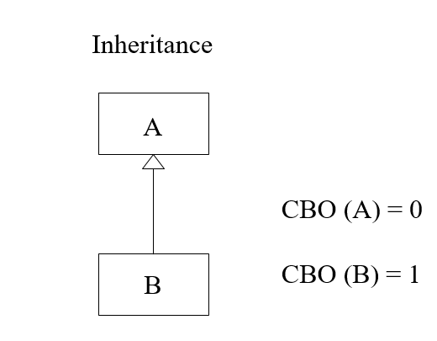
Coupling Between Object Classes (CBO)

Slide 4
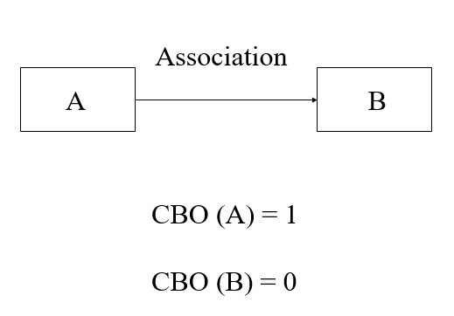
Coupling Between Object Classes (CBO)

Slide 5
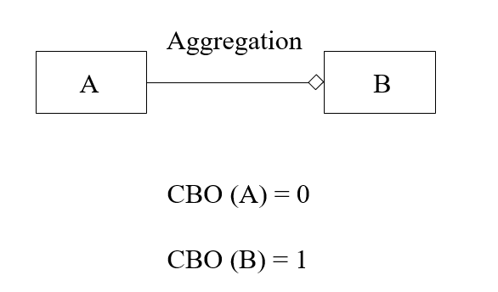
Coupling Between Object Classes (CBO)

Slide 6
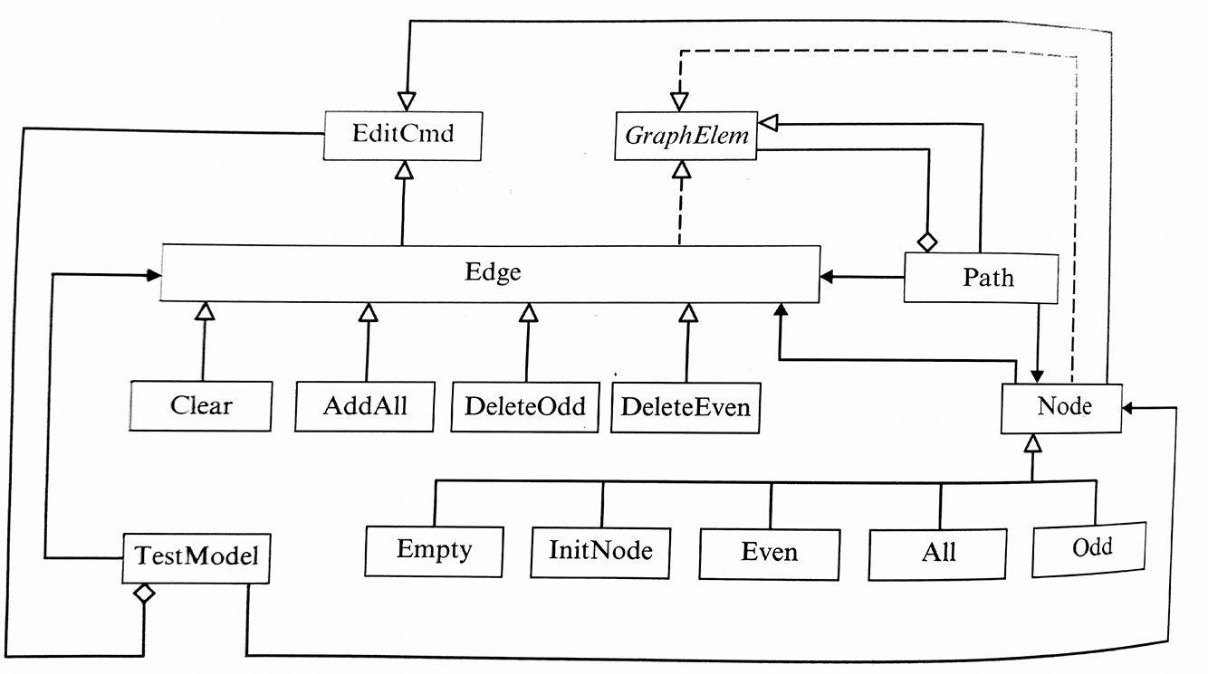
CBO = 0 : EditCmd, GraphElem
CBO = 1 :Clear, AddAll, DeleteOdd, DeleteEven, Empty, InitNode, Even, All, Odd
CBO = 2 : Edge
CBO = 3 : TestNodel , Node, Path
Notes:
CBO = 0 : EditCmd and GraphElem because they don’t depend on other classes.
CBO = 1 : The children of Edge and the children of Node .
CBO = 2 : Edge because it depends on EditCmd and GraphElem
CBO = 3 : TestModel, which depends on Node , Edge , and EditCmd.
Node, which depends on EditCmd, Edge and GraphElem.
Path, which depends on Edge, Node and GraphElem

Slide 7
Response for a Class (RFC)
RFC (C) = |{ m : m is a method of C, or m is called by a method of C }|
The higher the RFC, the more difficult to understand, test, maintain, and reuse the class due to higher dependencies of the class on other classes.

Slide 8
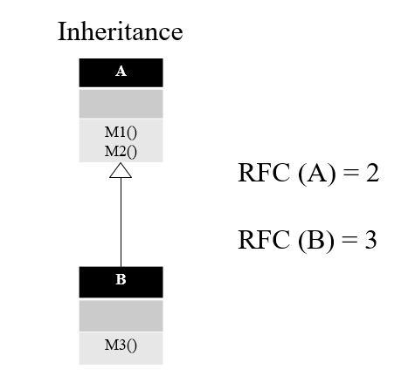
Notes:
這是個 Inheritance 範例 ， B class 繼承 A class ，A class 只能使用自己的 M1(), M2() methods ， B class 可以使用父類別的 methods M1() , M2() ，也有自己的methods M3()，So RFC(A) = 2 ，RFC(B) = 3
This is an inheritance example. Class B extends Class A. Class A can only use M1() and M2() methods inside itself, while Class B can use M1(), M2() in Class A, and M3() in Class B, so the RFC of A is 2. The RFC of B is 3.

Slide 9
Association
A
M1() M2()
B
M3()
RFC (A) = 3
RFC (B) = 1
Notes:
這是個 Association 範例 ， ， A class association B class ，A class 可以使用自己的 M1(), M2() methods ，也可以使用 B class M3()， B class 可以使用自己的 M3() methods ，So RFC(A) = 3 ，RFC(B) = 1
This is the example of association. Class A is in association with Class B. Class A can use M1(), M2() and M3(). Class B can use M3() methods only, so the RFC of A is 3 and the RFC of B is 1.

Slide 10
Aggregation
A
M1() M2()
B
M3()
RFC (A) = 2
RFC (B) = 3
Notes:
這是個 Aggregation 範例 ， they are Aggregation relationship ，and the dimond is 指向 B，A class 可以使用自己的 M1(), M2() methods，但不能使用 B class ， B class 可以使用 Class A的 methods M1() , M2() ，也有自己的methods M3() ，Because the dimond ，So RFC(A) = 2 ，RFC(B) = 3
This is the example of aggregation. The relationship between the two classes is aggregation and the diamonds is pointing to B. Class A can use M1(), M2() methods but no M3() methods. Class B can use the two methods in class A and also M3() methods, because of the diamond. Therefore the RFC of A is 2, and the RFC of B is 3.

Slide 11
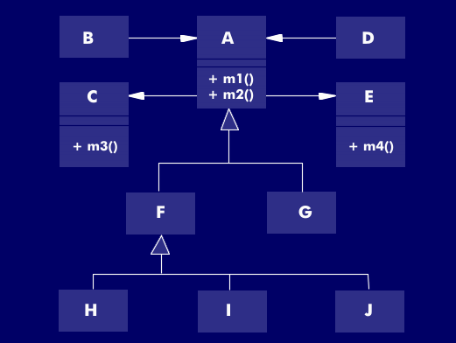
RFC(A) = 4
RFC(B) = 2
RFC(C) = 1
RFC(F) = 4
Notes:
RFC(A) = 4 and RFC(B) = 2
RFC(C) = 1 and RFC(F) = 0.

Slide 12
Lack of Cohesion in Methods
LCOM (C) = n * (n-1) / 2 - 2 *
|{ (mi, mj) : mi and mj share an attribute of C }|
LCOM measures the number of pairs of methods of C that do not share a common attribute.
Class exercise:
Is it possible to derive a metric called “cohesion of methods of a class?”
If so, what would be the formula?

Slide 13
A
a,b,c,d,e
M1() M2() M3()
If :
M1 has a,b,c attributes
M2 has c,d attributes
M3 has e attributes
LCOM(A) = 1

